Slide 1
Automatic Defect Recognition in X-ray Testing using Computer Vision
Domingo Mery – Carlos Arteta
Department of Computer Science
Universidad Católica de Chile
Department of Engineering Science
University of Oxford, UK
WACV - 2017, Santa Rosa, CA, March 2017

Slide 2
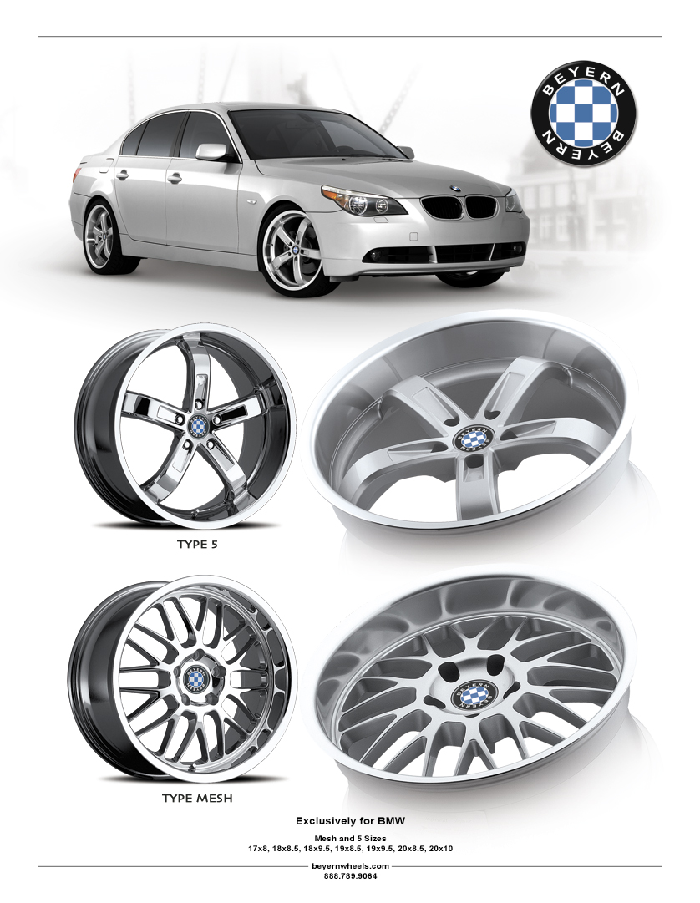
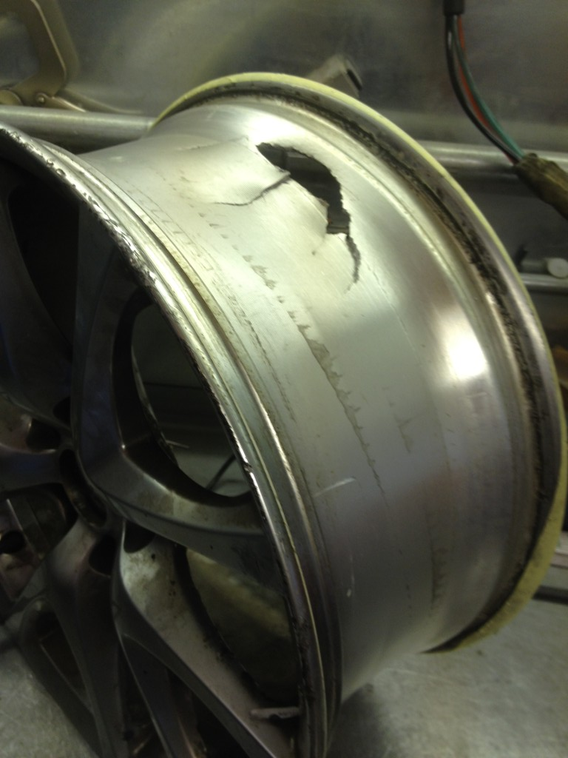
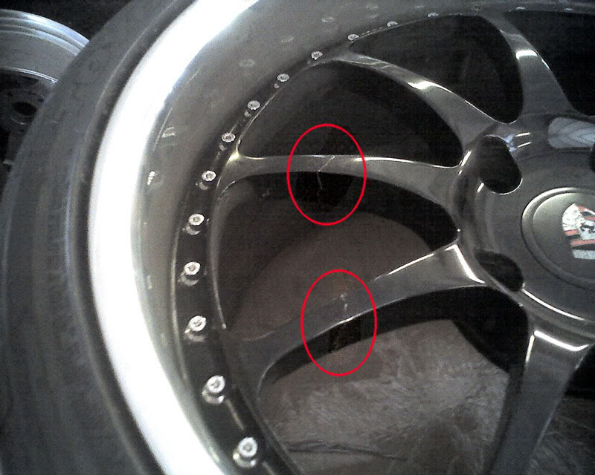
X-ray testing: Castings

Slide 3
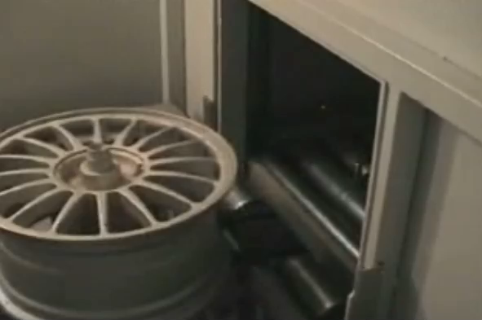
X-ray testing: Castings

Slide 4
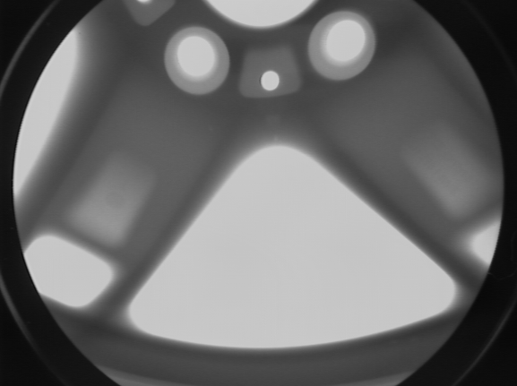
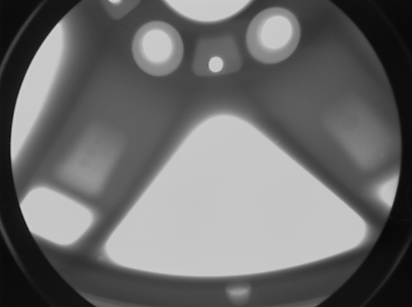
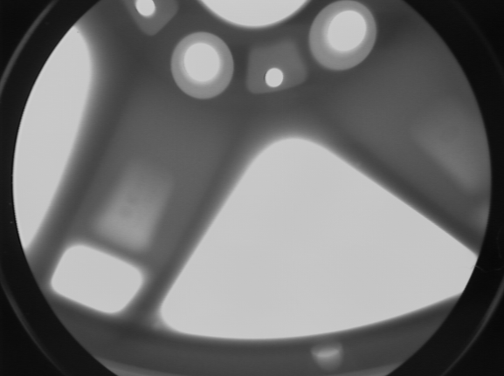
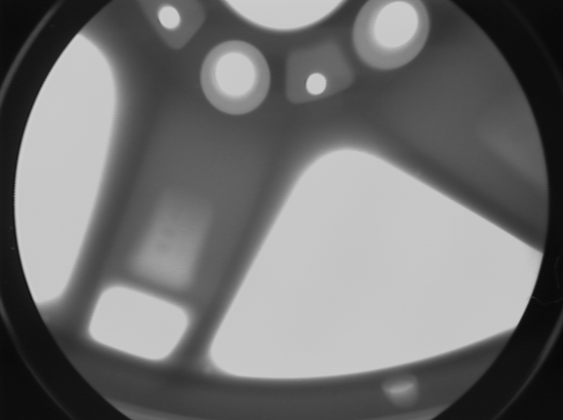
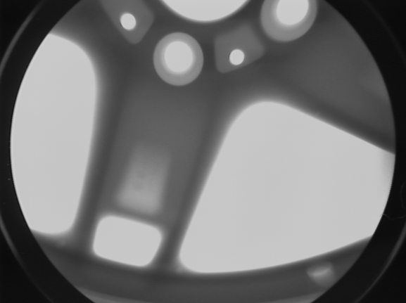
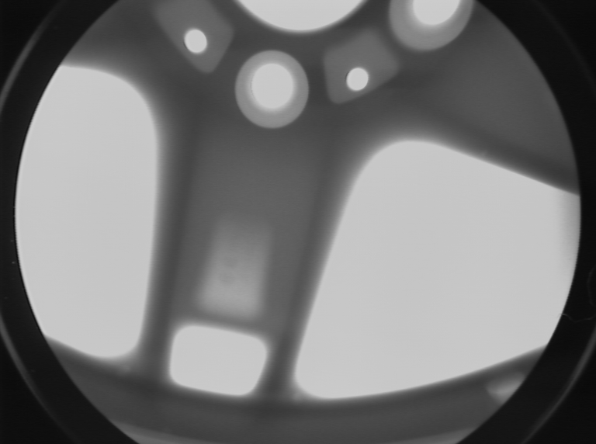
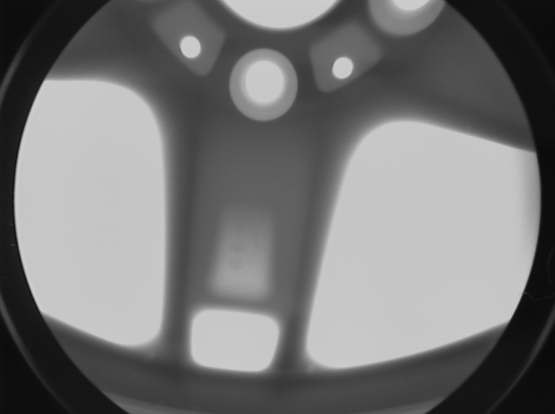
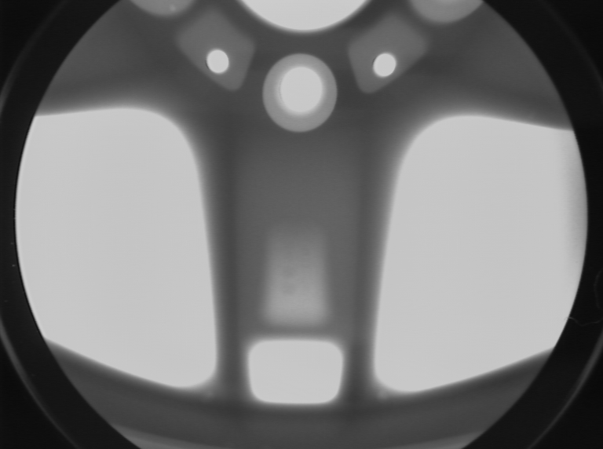
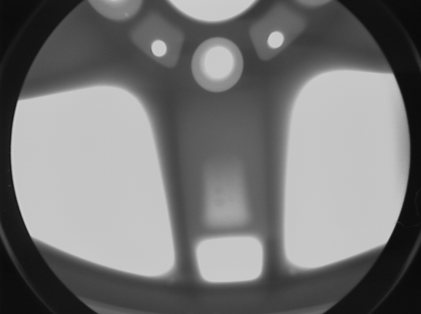
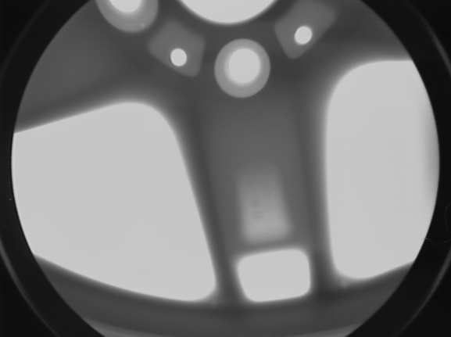
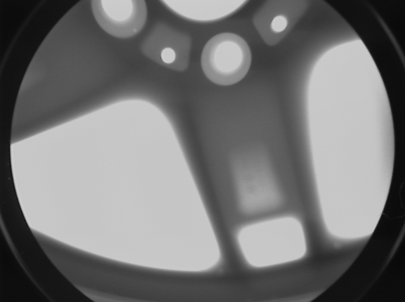
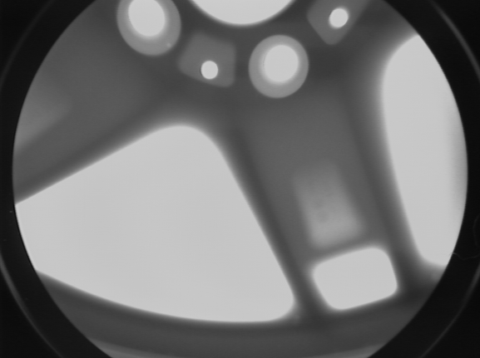
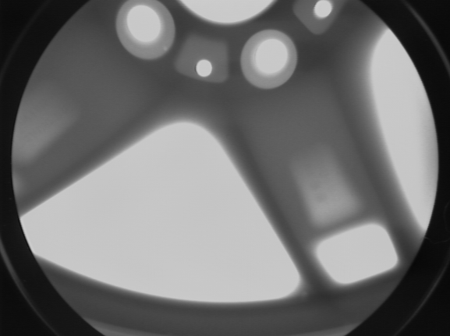
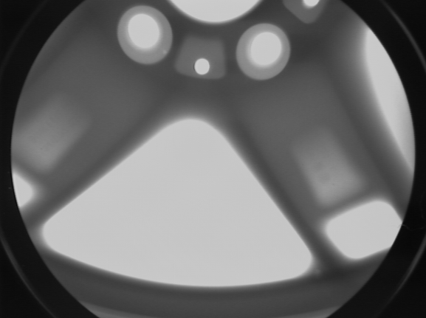
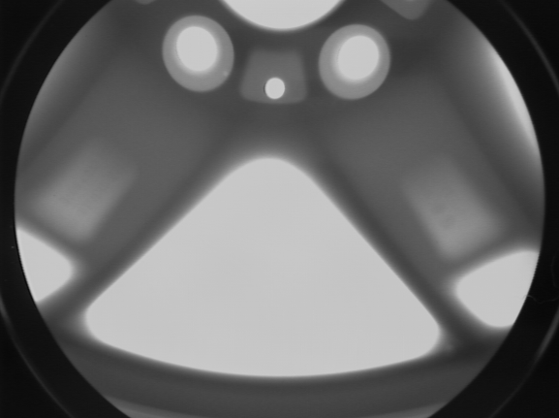
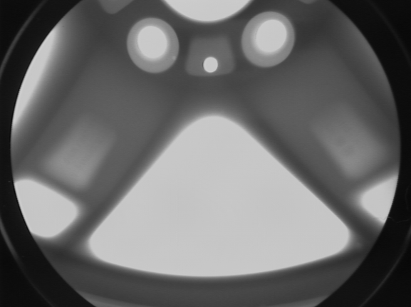
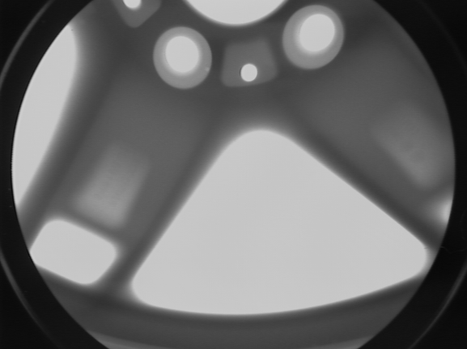
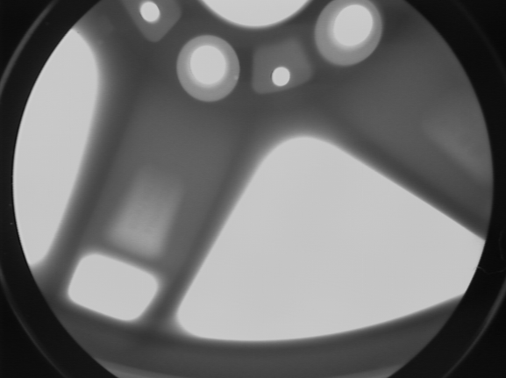
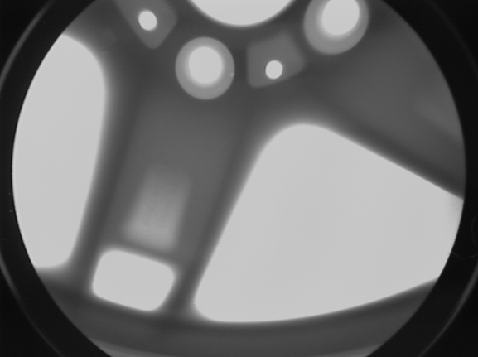
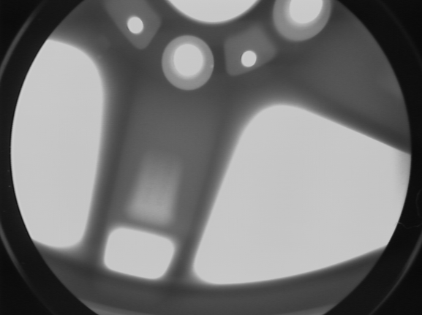
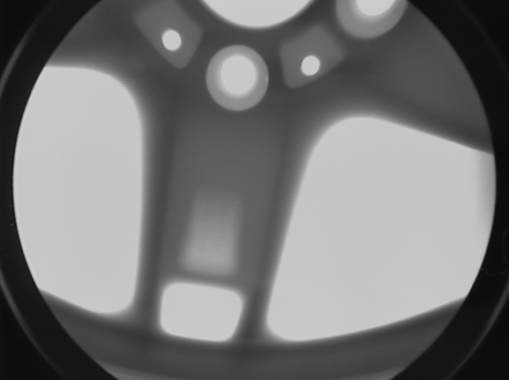
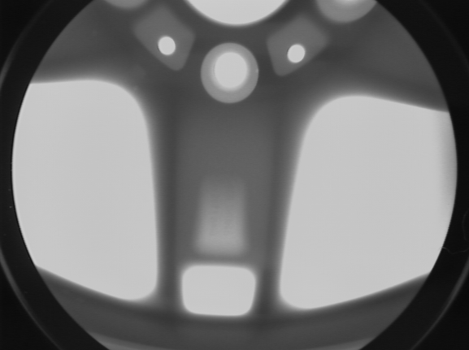



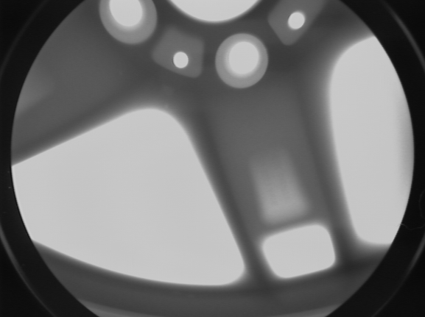

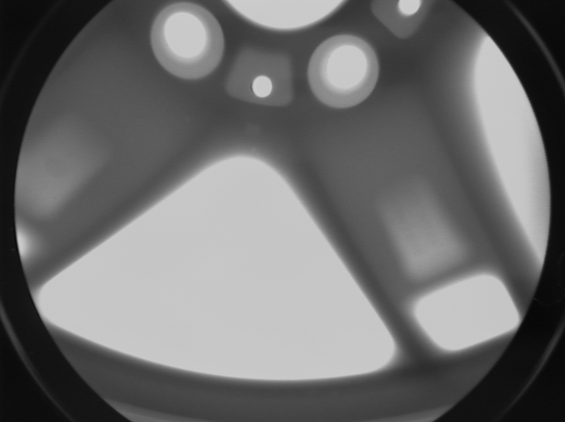
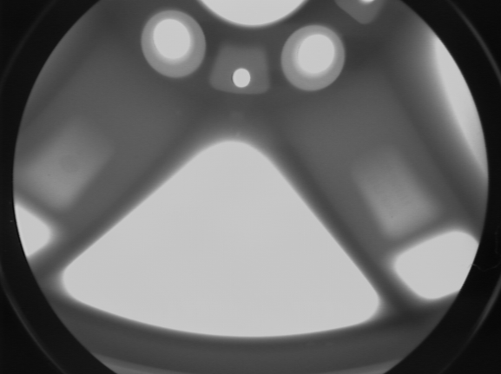
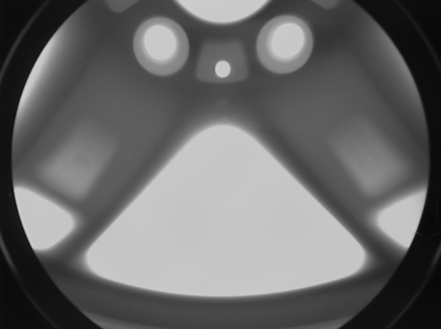
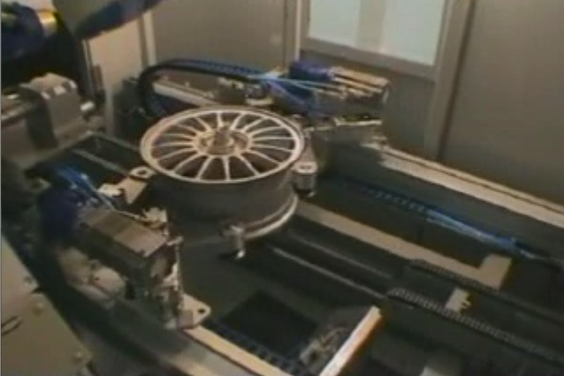
X-ray testing: Castings

Slide 5

X-ray testing: Castings

Slide 6
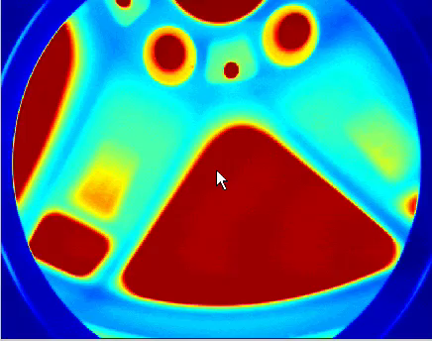
X-ray testing: Castings

Slide 7
X-ray testing: Castings

Slide 8
Automatic Defect Recognition in X-ray Testing using Computer Vision
Domingo Mery – Carlos Arteta
Department of Computer Science
Universidad Católica de Chile
Department of Engineering Science
University of Oxford, UK
WACV - 2017, Santa Rosa, CA, March 2017

Slide 9
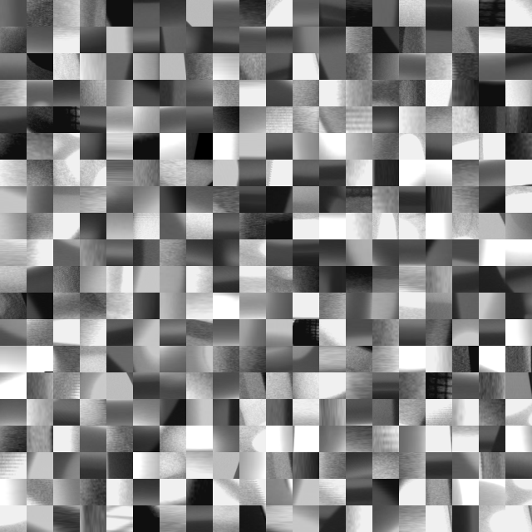
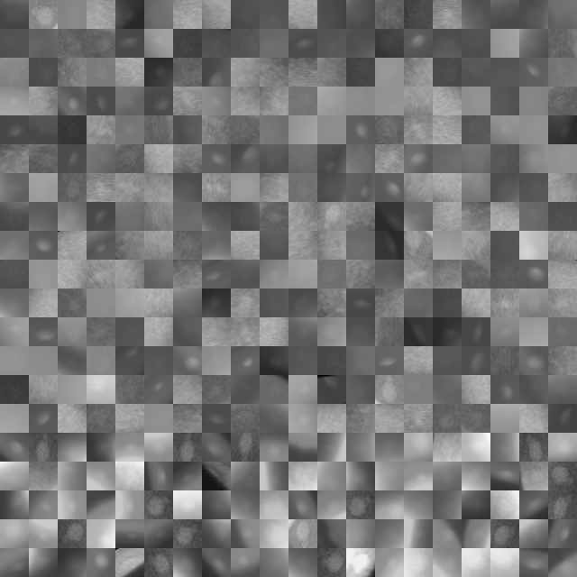
X-ray testing: Dataset & Evaluation Protocol
GDXray dataset
Casting X-ray Images
Cropped Images
Resize (32x32)
Data Augmentation
23.760 23.760
No-defects Defects
NO-DEFECTS
DEFECTS
Hold-out protocol:
 |  | No-defects | Defects | Total | %
Learning⁺ | Training | 12.168 | 12.168 | 24.336 | 51.2%
 | Validation | 4.056 | 4.056 | 8.112 | 17.1%
Testing⁺ |  | 7.536 | 7.536 | 15.072 | 31.7%
 | TOTAL | 23.760 | 23.760 | 47.520 | 100.0%

Slide 10
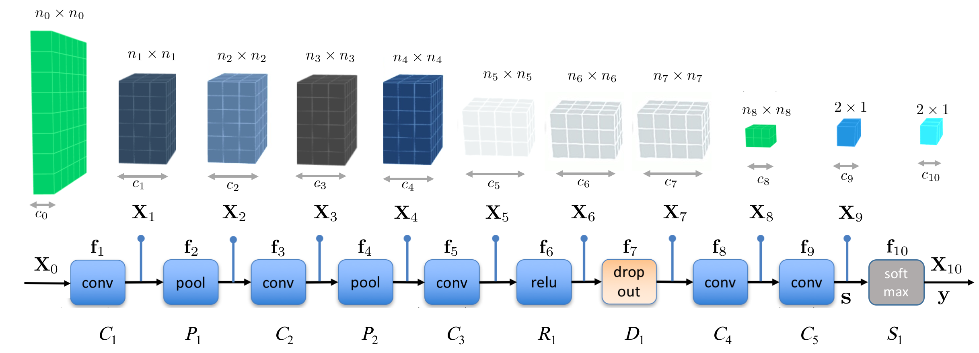
X-ray testing: Tested Computer Vision Methods
Features: LBP, BSIF, BRISK, HOG, SURF, SIFT, CLP, INT, DCT, Fourier, Gabor, Haralick, Sparse representations, Deep models (VGG, AlexNet, GoogleNet, Xnet)
Classifiers: KNN, SVM, ANN, SRC, SoftMax.
New CNN: Xnet
10 layers
conv, pool, relu
pre-trained on
ImageNet

Slide 11
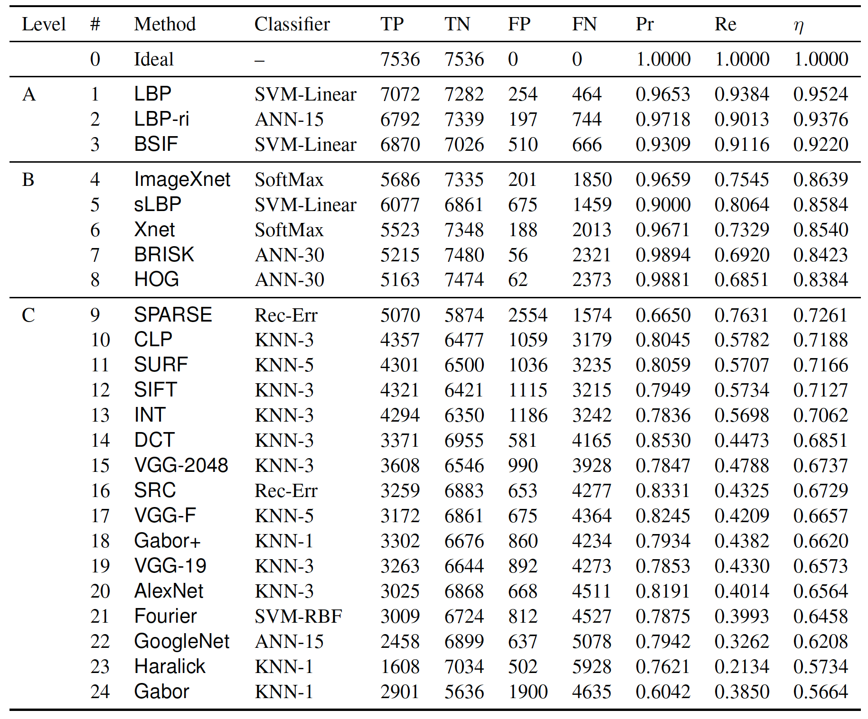
X-ray testing: Experimental Results - Performance

Slide 12

And the winner is...

Slide 13
X-ray testing: Experimental Results - Performance

Slide 14
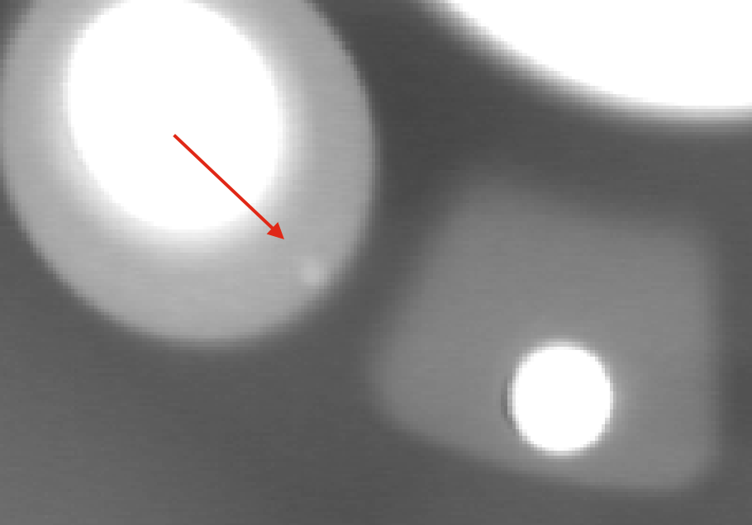
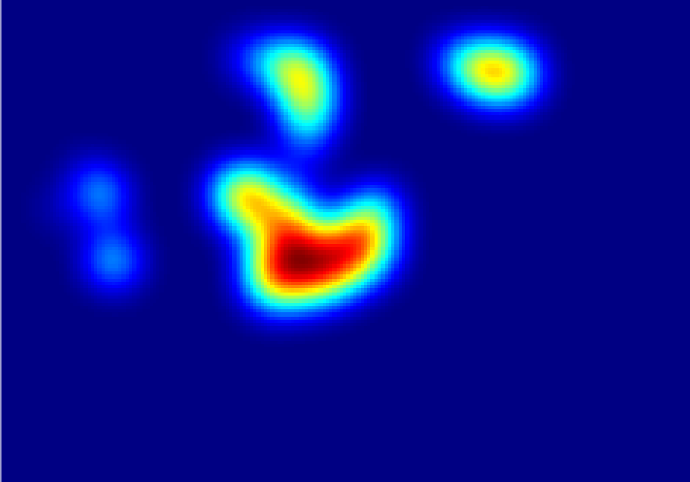
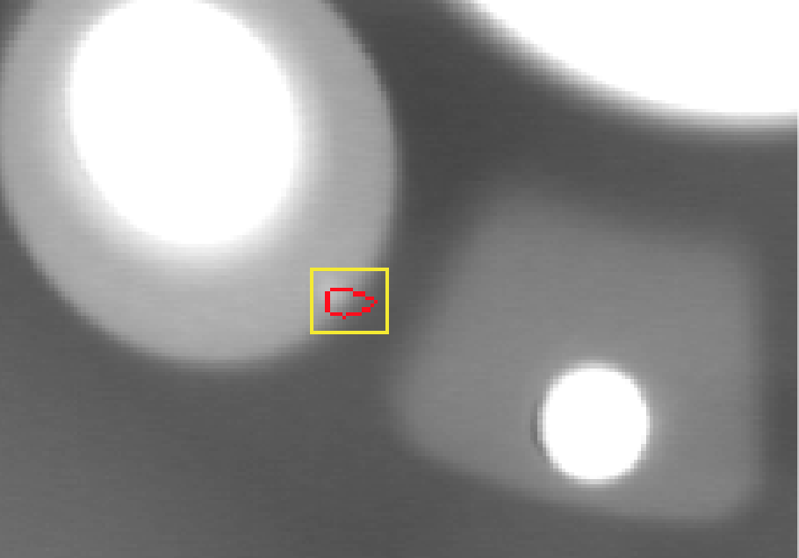
X-ray testing: Experimental Results - SlidingWindows
Detection using sliding windows with LBP and SVM-Lin.

Slide 15
X-ray testing: Conclusions
Comparative evaluation of 24 computer vision algorithms that can be used in the automated defect recognition in X-ray testing (including deep learning, sparse representations and classical pattern recognition strategies).
New dataset containing 47.520 cropped X-ray images of 32 x 32 pixels with defects and no-defects in automotive components.
Evaluation protocol that can be used to experiment on the dataset.
Matlab code and dataset are available on-line
The best performance was achieved by a simple LBP descriptor with a SVM-linear classifier obtaining 95.2% of accuracy.
Preliminary results with CNN models showed that features extracted from CNN networks have medium performance.
This methodology can be applied to other kind of defects (such as discontinuities in the welding process, concrete defects, glass defects or steel surface defects among others) if we have a large enough database of representative images.

Slide 16
X-ray testing: Conclusions
24 computer vision algorithms for defect recognition.
New dataset with 47.520 cropped X-ray images.
Matlab code available on-line
The best performance: SVM + LBP = 95.2%.
Methodology can be applied to other kind of defects.

Slide 17
Automatic Defect Recognition in X-ray Testing using Computer Vision
Domingo Mery – Carlos Arteta
Department of Computer Science
Universidad Católica de Chile
Department of Engineering Science
University of Oxford, UK
WACV - 2017, Santa Rosa, CA, March 2017

